Slide 1
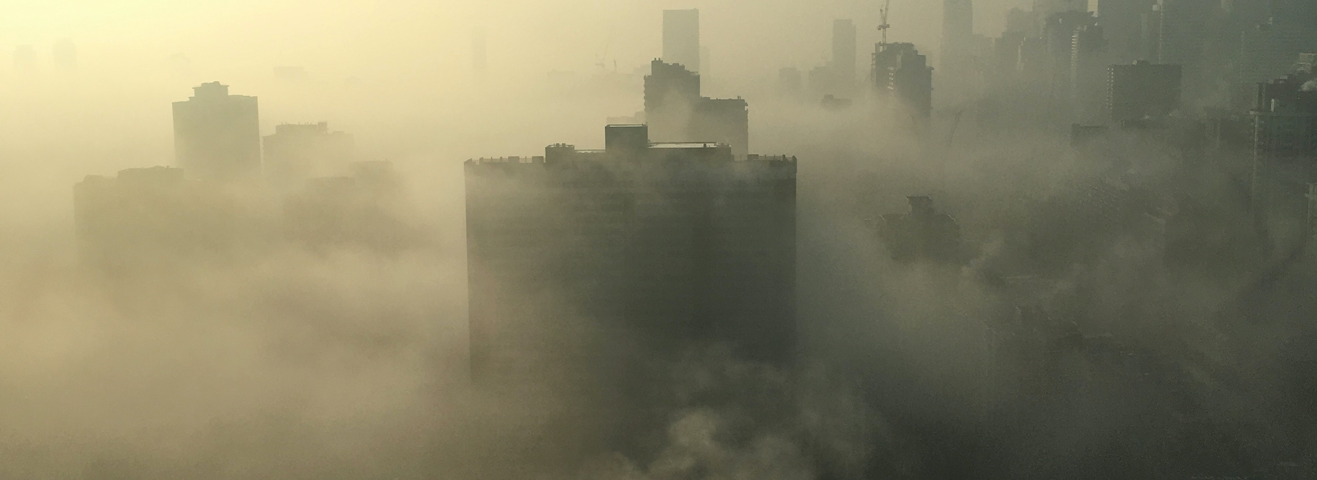
AQI vs death rate prediction
Nattawaree Piyarat
Brainstation – data science bootcamp

Slide 2

Problem statement
Can machine learning accurately predict mortality rates based on the Air Quality Index (AQI)?
Are there correlations between air quality and health outcomes, particularly mortality rates, and air pollution stems from various sources such as wildfires, dust, vehicular emissions, and industrial activities?
Focus group (selected Asian countries).
  Bangladesh
  Bhutan
  China
  India
  Indonesia
  Sri Lanka
  Thailand
Notes:
"Can machine learning accurately predict mortality rates based on the Air Quality Index (AQI)? A
re there discernible correlations between air quality and health outcomes, particularly mortality rates, and what are the key factors influencing air quality?
In contemporary times, we are increasingly aware of the effects of air pollution from various sources such as wildfires, dust, vehicular emissions, and industrial activities.
This study aims to investigate the relationship between air quality, measured by the AQI, and mortality rates, with a focus on selected Asian countries.

Slide 3
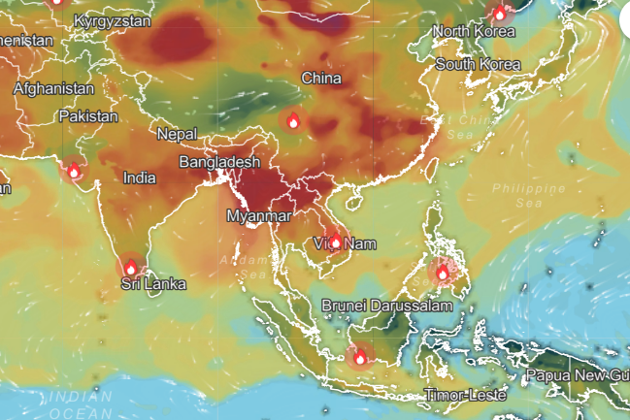
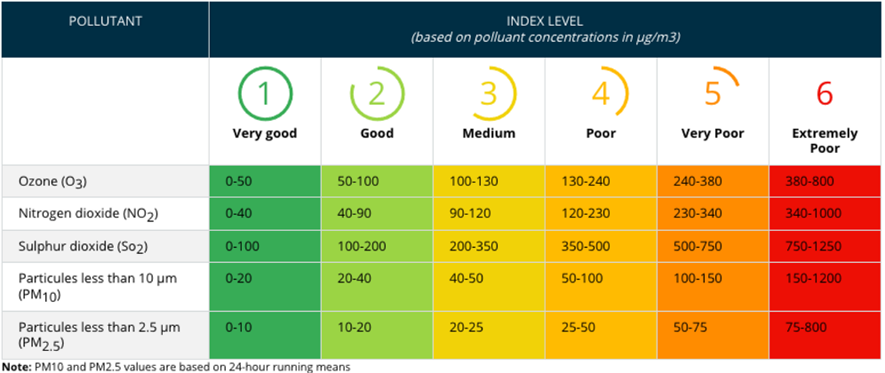
AQI (Air quality index)
Focus >= Level4
Picture from IQAir website
PM 2.5 meaning: Fine particulate matter is defined as particles that are 2.5 microns or less in diameter
Notes:
I can expand other countries by add more data pionts

Slide 4
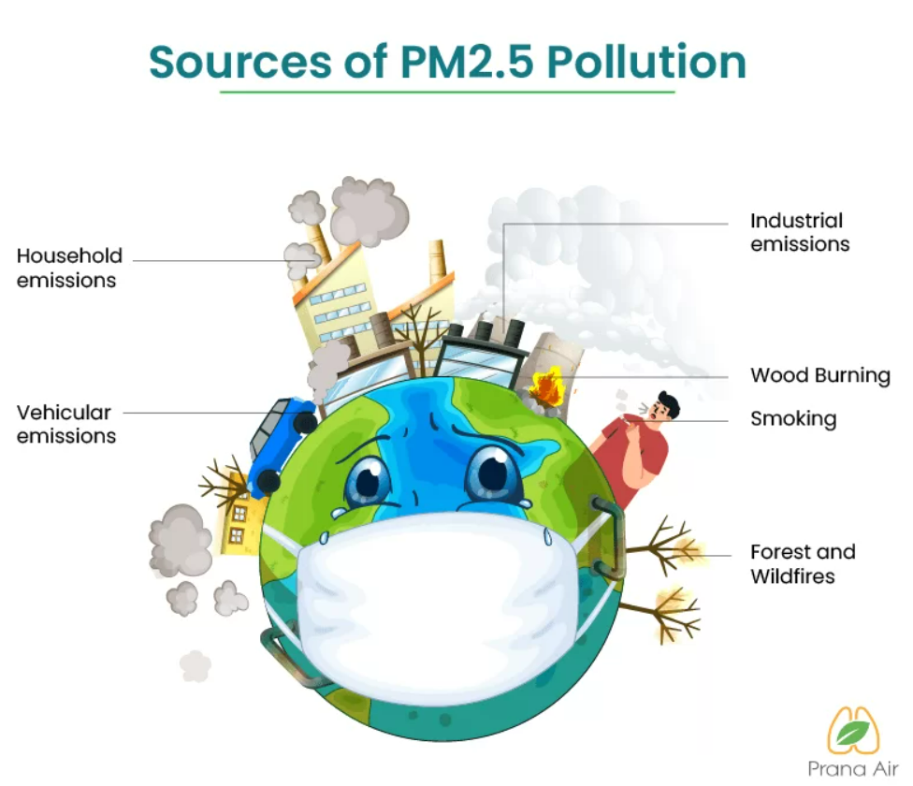
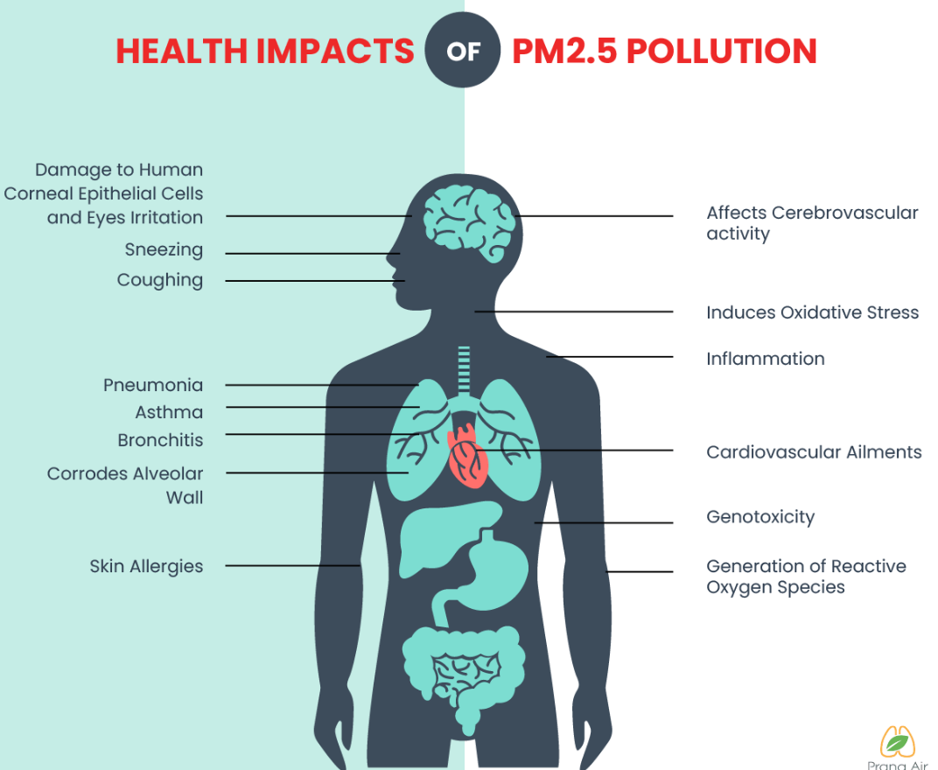

Slide 5




Data Science
The machine learning approach will use historical AQI data, and historical death causes data. And predict the relationship between air quality and the number of deaths which is assumed caused by high AQI.
Approach
  Linear Regression
  Logistic Regression
  Time series
The results of this project should raise awareness of air pollution and reduce the number of deaths of people by at least 1%, especially in the concerned areas.
Notes:
"The outcomes of this project are expected to heighten awareness of air pollution and subsequently decrease the mortality rate by at least 1%, particularly in the identified regions of concern."

Slide 6


Data set
Dataset from WHO database (Air quality index, number of deaths by cause, pollution, dust, wildfire)
Currently, I reference the datasets below.
Air quality index year 2009 – 2019 from WHO
  Country, City
  Year
  Number of PM10, PM2.5, NO2
Number of deaths by cause year 2016 – 2019 from WHO
  Country
  Year
  Age group
  Cause of death
  Number of deaths, death rate
Additional dataset
  Historical AQI with separated by pollutants to predict AQI

Slide 7
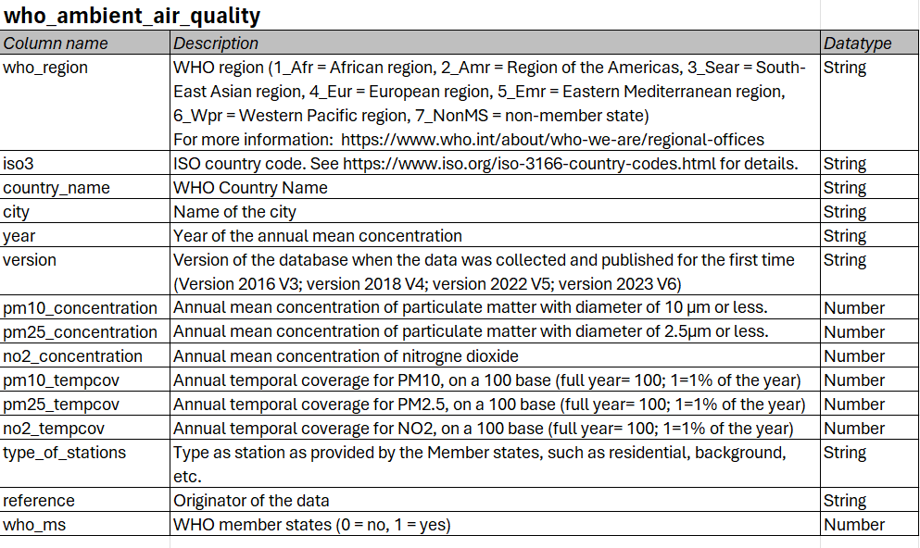
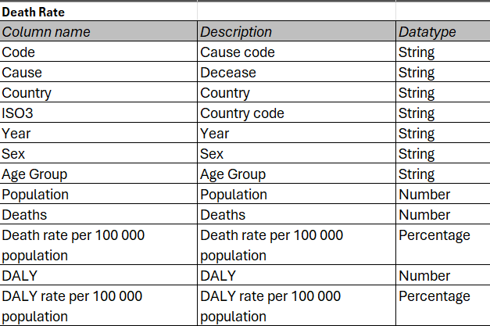
Data dictionary

Slide 8
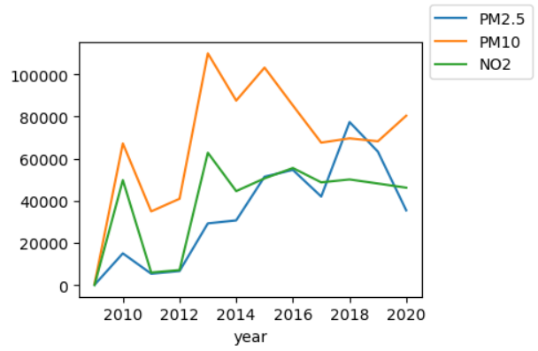
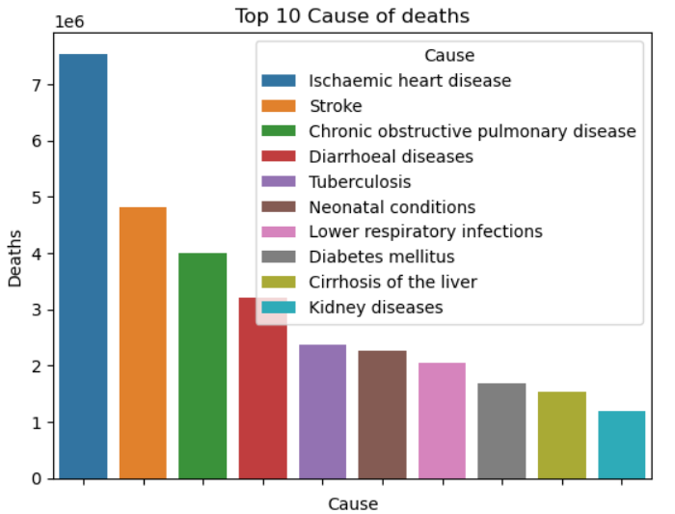
Finding (1)
PM 10 peaked during 2013 – 2015 and PM2.5 increased and peaked in 2018.
'Ischaemic heart disease' is the top 1 of the cause of death.
The WHO explains that household air pollution is identified as a primary source of outdoor air pollution.
Notes:
ischaemic heart disease อัสกิมมิค ฮาร์ต ดีซีส

Slide 9
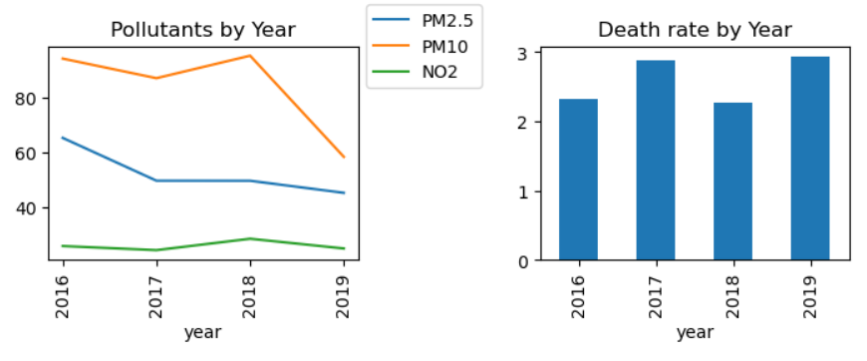
Finding(2) –affecting the goal
Observation In 2019, pollutant levels tended to decrease, yet the death rate increased. This suggests that pollution may not have an immediate impact but requires several years to affect mortality rates.

Slide 10
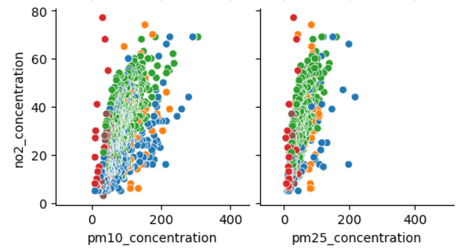
Finding(3)
NO₂, PM10, PM2.5 linear relationship

Slide 11
Finding(4)
Linear Regression | X (features) | Result (R²) | (R²) add China
y = number of deaths | PM10 | 0.31 | 0.77
 | PM2.5 | 0.32 | 0.77
 | PM10, PM2.5 | 0.48 | 0.86
Focus only on 'Ischaemic heart disease’ the Death rate correlates with PM10, PM2.5.
If use all diseases R² shows 0.00
Logistic Regression | X | Result (R²)
y = Unhealthy | PM10, PM2.5, NO2 | 1

Slide 12
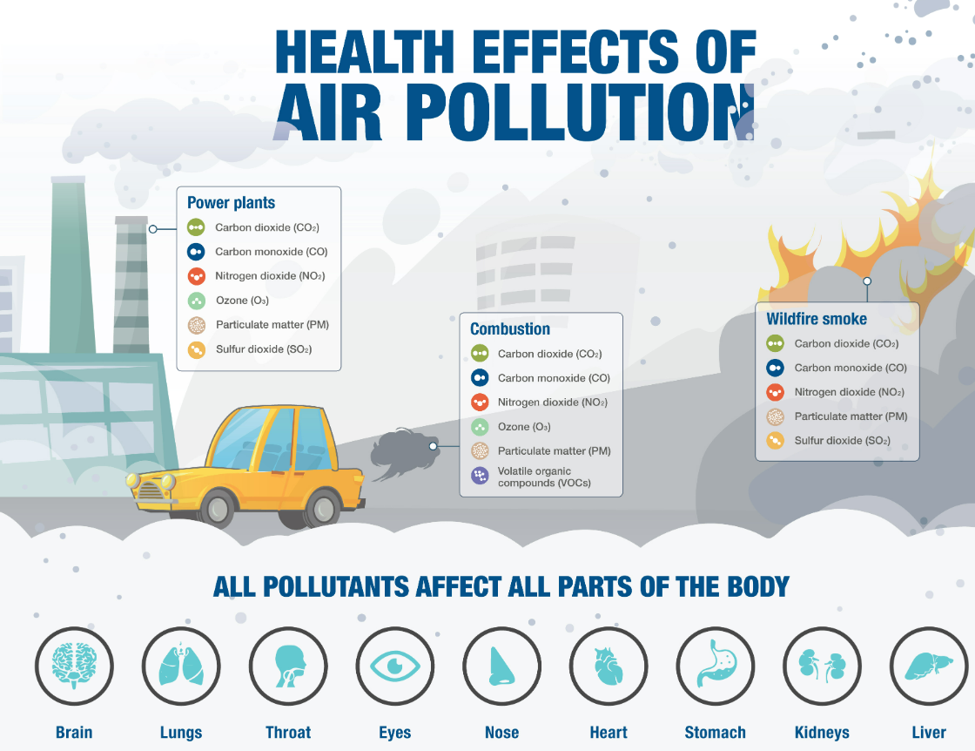

Slide 13
Next step
The time delay in observing the impact of the Air Quality Index (AQI) on mortality, my approach involves predicting the AQI from each pollutant or forecasting illness instead.
Plan to add more datasets that contain many pollutants (O₃, PM2.5, PM10, CO₂, NO₂, CO, SO₂). And illness dataset.
Using machine learning to predict AQI and illness
  Linear Regression
  Time series
  Decision Tree
  KNN
Notes:
ozone, fine particulate matter, nitrogen dioxide, carbon monoxide, sulphur dioxide

Slide 14


Slide 15
Reference
WHO. WHO Ambient Air Quality Database (update 2023). Version 6.0. Geneva, World Health Organization, 2023.

